Slide 1
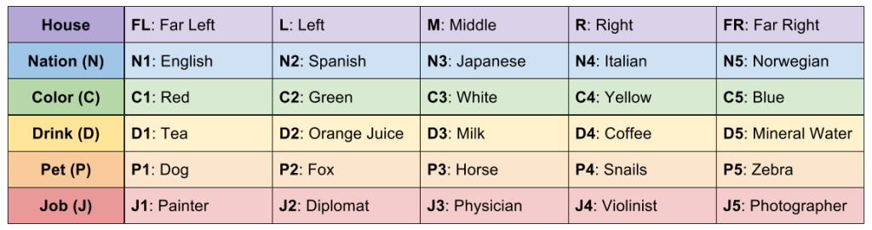
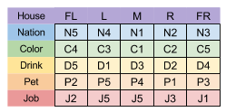
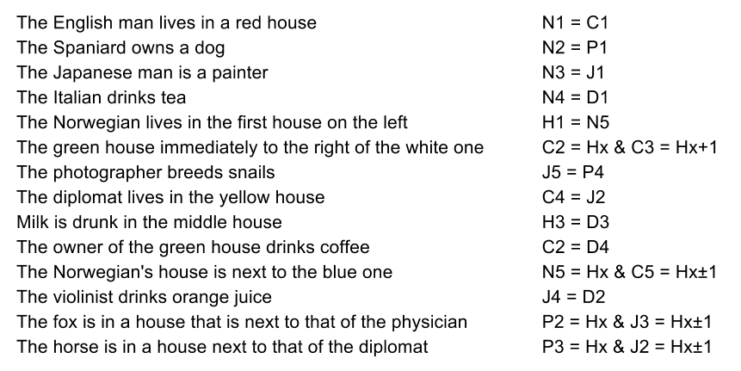
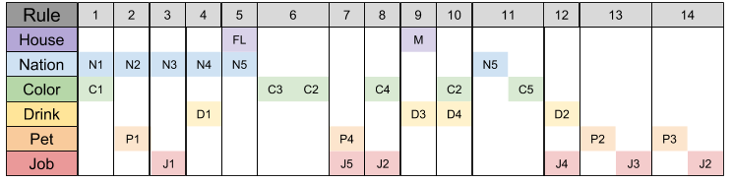
Five men who are originally from different countries live in consecutive houses on a street. Given are each man's job, the colors their houses are painted, the favorite drink of each household, and the pets they keep. We want to know: Who owns a zebra? And whose favorite drink is mineral water? The following rules (constraints) are provided:
The English man lives in a red house
The Spaniard owns a dog
The Japanese man is a painter
The Italian drinks tea
The Norwegian lives in the first house on the left
The green house immediately to the right of the white one
The photographer breeds snails
The diplomat lives in the yellow house
Milk is drunk in the middle house
The owner of the green house drinks coffee
The Norwegian’s house is next to the blue one
The violinist drinks orange juice
The fox is in a house that is next to that of the physician
The horse is in a house next to that of the diplomat

Slide 2
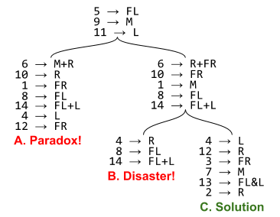
Constraint Satisfaction
Zebra Puzzle
Another application of search is constraint satisfaction.
Rather than searching through states, we search through possible assignments of variables
More formally:
Given a collection of n variables, with each variable Vn (V1, V2, etc) having a domain of possible values D1, D2, D3, etc., it can take on, and a set of k constraints on those possible values C1, C2, … Ck:
A solution is an assignment of values to variables, with each value assigned being from the correct domain for that variable
A solution that assigns a value to all variables is complete (otherwise it is partial).
A solution is consistent iff all constraints are satisfied by it
A solution is correct iff it is complete and consistent.
An advantage of constraint satisfaction is that it’s general; we can write a general constraint-satisfaction solver and turn it loose on ANY problem that can be formulated appropriately
We construct a constraint graph, with each node a variable, connected if they share a constraint.
We can then apply search techniques to that graph
We can also go beyond “this isn’t a solution, go on to the next state” by identifying which constraints are violated & focusing on assignments that satisfy them
Many real-world problems fall into this category; for example, observation time on the Hubble telescope involves starting & ending times & telescope orientations, subject to a variety of priority & power constraints

Slide 3
Constraints
There are several types of constraints:
Unary constraints apply to 1 variable
Binary constraints apply to 2 variables
N-ary, etc., …( follow from here)
Global constraints apply universally
ALLDIFF: each variable must be assigned a unique value.
There are also softer preference constraints in which we have a preferred state and apply a penalty (cost) to other options
I’d prefer to fly in the afternoon, but will fly in the morning if it’ll save me $100 or more.
Prof. Smith prefers to teach in the morning, Prof. Jones in the afternoon. A schedule with both of them teaching in the afternoon is valid but not optimal.

Slide 4
Constraint Propagation & Inference
In Constraint Satisfaction Problems (CSPs), an algorithm can search (try another assignment of values to variables) or do a type of inference called constraint propagation
Using the constraints already known to reduce the number of legal values for a variable, which in turn might limit possible values for other variables.
Key idea is local consistency
Each variable is a node on a constraint graph.
Enforcing local consistency throughout the constraint graph causes inconsistent values to be eliminated
A variable is node-consistent if all values in that variable’s domain satisfy the variable’s unary constraints
Node consistency can be enforced one variable at a time.
N-ary constraints can be made into (decomposed)binary constraints
Therefore most CSP solvers only work with binary constraints
But we can generalize this concept to hyperarc consistency or generalized arc consistency to deal with multiple values
A variable is arc-consistent if every value in that variable’s domain satisfies the variable’s binary constraints
Arc consistency eliminates values of each variable domain that can never satisfy a particular constraint (an arc).
More formally, X_{i} is arc-consistent with respect to X_{j} if for every value in D_{i} there exists some value D_{j} that satisfies the binary constraint
A network is arc-consistent if every variable is arc-consistent with respect to every other variable
For example, suppose X and Y are integers in {1,2,3…9,10} and we add the constraint Y = X².
We can make this arc-consistent if we reduce the range of X to {1, 2, 3} (to make X arc-consistent with Y) and Y to {1, 4, 9} (to make Y arc-consistent with X).

Slide 5
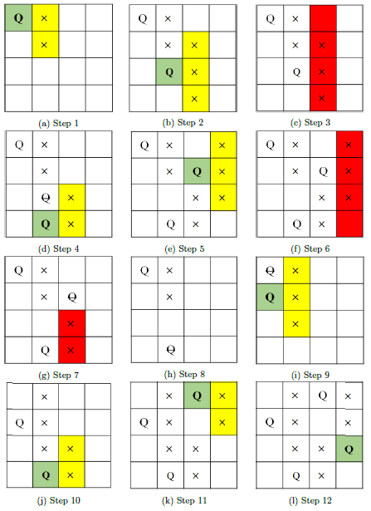
AC-3
The most popular algorithm for arc consistency is AC 3
Maintain a queue (or set) of arcs to consider; (initially this is all arcs in the CSP)
Binary constraints become two arcs, one in each direction
Take an arbitrary arc (X_{i}, X_{j}) from the queue
make X_{i} arc-consistent with X_{j}
If this has no effect on D_{i}
go on to the next arc
But if this reduces D_{i},
add to the queue all arcs (X_{k}, X_{i}) [where X_{k} is a neighbor of X_{i}]
(The reduction in D_{i} might affect D_{k} even if we’ve already processed D_{k})
If D_{k} is reduced down to nothing
CSP has no consistent solution
return failure
Otherwise continue (until no more arcs are in queue)
At this point we have a CSP equivalent to the original—it has the same solutions—but it has smaller domains and so can be searched faster
If variables all have domains of size at most d and there are c binary constraints, checking consistency of an arc takes at most time O(d²) and so we get total worst-case time of O(cd³)

Slide 6
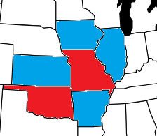
Path consistency
Arc consistency can go a long way (sometimes all the way) to a solution
Solution, by reducing every domain size to 1
OR -- Verifying that there is no solution, by reducing some domain size to 0
But sometimes not enough
Consider the map coloring with only R, B
Every variable can be arc-consistent (R at one end, B at the other) but still no solution
Since MO, IL, KY all touch each other, we need 3 colors just for them
Path consistency tightens binary constraints by looking at triples
A 2-variable set {X_{i}, X_{j}} is path-consistent with respect to a third variable X_{m}
if for every assignment {X_{i} = a, X_{j} = b} consistent with binary constraints on X_{i} and X_{j}
there is assignment to X_{m} that satisfies binary constraints on (X_{i}, X_{m}) and (X_{m}, X_{j})
That is, there is an assignment for all variables that makes a path from X_{i} to X_{j} passing through X_{m} consistent with all binary constraints on all 3 variables
So, for example, we try the 2-color map problem for MO, IL, IN, KY.
Possible solutions are {MO = R, IL = B} and {IN = R, IL = B} So far so good.
But with both of those assignments, KY can be neither R nor B because it would conflict with one or the other
Therefore there is no valid option for KY. The domain is of size 0, which tells us this problem has no solution.
The PC-2 algorithm applies the same basic idea as the AC-3 algorithm.

Slide 7
K-consistency
Taking this further, a CSP is K-consistent if for any set of K-1 variables and for any consistent assignment to those variables, a consistent value can be assigned to the k^{th} variable.
1-consistency says given the empty set we can make any one variable consistent (node consistency)
2-consistency is the same as arc consistency
3-consistency is the same as path consistency
A CSP is strongly K-consistent if it is k-consistent and also (k-1) consistent, (k-2) consistent, etc all the way down to node consistent.
If we have a graph of N nodes and make it strongly N consistent, we have a solution
Choose any consistent value for X1.
We are guaranteed to be able to choose a consistent value for X2 because it is 2-consistent
We can also choose a consistent value for X3 because it is 3-consistent
And so on to Xn. Worst case time is O(n²d)
No free lunch! Establishing strong N-consistency takes exponential time and space in worst case
In practice, we commonly compute 2-consistency & sometimes 3-consistency, then fall back on search

Slide 8
Global constraints
Recall that a global constraint is one involving an arbitrary number of variables (not necessarily all)
Special algorithms can be used to reduce the search space or detect inconsistency
Consider the Alldiff constraint. If we have M values involved in the constraint, and there are a total of N possible values among all of them, and M > N, the constraint cannot be satisfied
This leads to a simple algorithm:
If any variable has a singleton domain (1 possible value), assign that value to that variable, and remove that value from the domain of the remaining variables
Repeat as long as there are singletons.
If an empty domain ever occurs or there are more variables than domain values, an inconsistency has been detected

Slide 9
Other constraints
We also have the resource constraint, also known as the atmost constraint.
We have 4 tasks {P1,P2,P3,P4} and 10 employees.
We can specify this as atmost(10, P1, P2, P3, P4)
Check the sum of the minimum values for each job
If each variable has the domain {3, 4, 5, 6} (need at least 3 employees for each job), the constraint cannot be satisfied
We can also enforce consistency by deleting maximum values if they are inconsistent with minima
If each variable has range {2, 3, 4, 5, 6}, we can delete values 5 & 6 (after assigning minimum numbers, there aren’t enough workers left to put 5 or more on 1 job)
A CSP is bounds consistent if for every variable X and both the lower and upper bounds of X, there exists some value of Y that satisfies the constraint between X and Y for every variable Y.

Slide 10
Backtracking search for CSPs
Some problems (e.g. Sudoku) can be solved entirely via constraint satisfaction
But sometimes after satisfying all constraints we do not have a unique solution
Could apply depth-limited search
A state is a partial assignment
A step is adding var = value
But this is problematic
The branching factor at top level is nd (assign any of d values to any of n variables)
At the next level it’s (n-1)d, and so on for n levels
Thus we generate n! * d^{n} leaves even though there are only d^{n} possible assignments
But this ignores commutativity
A problem is commutative if the order of application of any given set of actions has no effect on the outcome
CSP problems are commutative because when assigning values to variables we reach the same partial assignments regardless of application order
So we only need to consider one variable at each node in the search tree
We might choose between KY = red, KY = green, and KY = blue, but not between KY = red and MO = blue
With this restriction, the number of leaves is d^{n}.

Slide 11
Backtracking search
A backtracking search is a depth-first search that chooses values for one variable at a time and backtracks when a variable has no legal values left to assign
Choose a variable, then try all values in the domain of that variable in turn
If an inconsistency is found, then it returns a failure, causing the previous call to try another value
With uninformed depth-first search we could speed up search by applying problem-specific heuristics. CSPs can be sped up without problem-specific heuristics, by addressing these questions:
Which variable should be assigned next?
In what order should values be tried?
What inferences should be performed at each step in the search?
When the search arrives at an assignment that violates a constraint, can the search avoid repeating this failure?

Slide 12
Variable Ordering
Simplest method is to choose next unassigned variable
But this seldom leads to the most efficient search
For example, in our map coloring, after MO = red and IL = green, there is only 1 possible value for KY, so it makes sense to assign KY = blue immediately
And after that, assignment for IN is also forced, with only 1 possible value
This is the minimum-remaining-values heuristic: Choosing the variable with the fewest legal values
Also known as “most constrained variable” or “fail-first” heuristic
If some variable has 0 values left, it will be picked next and the failure detected immediately
Performs better than a random or static ordering, sometimes by a factor of 1000 or more, but it depends quite a bit on the problem
But MRV is no help choosing the first variable. In this case we use the degree heuristic, choosing the variable involved in the most binary constraints
Again, the idea is to reduce possible values in other variables as quickly as possible
MRV is more powerful; degree heuristic is a useful tie-breaker

Slide 13
Value ordering
Once we’ve selected a variable, what order do we try to assign its values?
The least-constraining-value heuristic prefers to use the value that rules out the fewest values in surrounding variables in the constraint graph
In general, we want the maximum flexibility for future assignments
Of course, if we’re looking for ALL solutions, not just the first, this doesn’t matter since we have to try them all eventually anyway
Likewise if there are no solutions
Choosing variables is fail-first (most constrained variable), choosing values is fail-last (least constraining value)
Choosing variables fail-first prunes off entire branches of the search tree earlier
For values, we only need to find one solution, so we look for the most likely

Slide 14
Local search for CSP
Local search techniques can be very effective for CSPs
Use a complete-state formulation, and start in a random state
Select a variable and search for a value that reduces the number of conflicts and constraint violations
The obvious heuristic is min-conflicts, the value that results in the minimum number of conflicts. If more than one value gives same minimum number of conflicts, choose arbitrarily
For n-queens, the solution is approximately independent of problem size, solving the 1,000,000 queens problem in 50 steps after initial assignment.
For this problem, solutions are dense throughout the search space
This has also been used in practical problems.
Scheduling observation time for the Hubble telescope used to take 3 weeks to schedule 1 week’s observations; now takes 10 minutes

Slide 15
Local search for CSP
Most of the local search methods we looked at can be used for CSP
CSP problems often have a series of plateaus, states 1 conflict away from a solution
Allowing sideways movement to other states with the same score allows exploring this space
Maintaining a taboo list of recently-visited states & not allowing return to them can prevent aimless wandering
Simulated annealing can also get a search off a plateau
Another approach is constraint weighting
Start with all constraints having a weight of 1
At each step, choose variable/value that minimizes total weights of violated constraints
Increment the weight of all constraints still violated
This adds topography, ensuring progress is possible, and adds weight to constraints that are proving difficult to satisfy
Another advantage of local search is that it minimizes the number of changes, useful in online or dynamic situations
Airline scheduling involves elaborate constraints of time, personnel, equipment, etc.
If something changes (bad weather at an airport, crew member ill, etc) we must find another solution
Local search will find something requiring only a few changes; re-starting the assignments from scratch might find a valid solution requiring dozens (or hundreds!) of changes

Slide 16
AND-OR trees
For some problems, we have choices which might be equally valid, or some things that must all be done, and other choices of which any one would work
We want dinner AND a movie; for dinner we can have pizza OR middle eastern OR Thai; what’s within walking distance?
Any of the restaurant options can be chosen as part of a solution
If a restaurant AND movie theater aren’t within the specified range, there is no solution to the overall problem no matter how good the restaurant is, even if there’s a pizza place, a middle eastern place, and a Thai place all right across the street
It can be represented with an AND-OR tree
A node in such a tree is solvable if
It is a terminal node
It is nonterminal whose successors are AND nodes that are all solvable or
It is nonterminal whose successors are OR nodes and at least one of them is solvable
Sample AND-OR tree, p. 101

Slide 17
Heuristic Bidirectional Search
A bidirectional search can be more time effective, if the two parallel searches actually intersect
A naïve bidirectional search can suffer from the missile metaphor problem: A missile and anti-missile can be targeted toward each other, and both miss
However, this is not a general problem; as it turns out, wave-shaping algorithms can be used to direct the two searches toward each other (diagram, p. 102)
Rather than front-to-end heuristic estimates, this method uses front to front estimates—heuristic cost of a path from some node in the “source” front to some node in the “goal” front
This helps address the frontiers problem—as each search front grows, storage space becomes a problem as the two fronts try to find each other
Or a frontier search is carried out
A node is selected and a BFS out a certain distance from it is carried out, and all nodes stored (usually in a hash table)
A forward search then starts from source S, targeting the perimeter nodes, using A* or ID-DFS
Likewise, a backward search from goal G, targeting the perimeter, can also be carried out
This results in opening about ¼ the nodes of a unidirectional search
While there is no connection between the S and G searches, their intersection is the empty set.
Once they collide, a search is carried out to find the optimal path within that (smaller) intersection set

